Slide 1
PRESENTATION SAMPLE
Hotel management system

Slide 2
THANK YOU!
Data exported through ODBC connection from MySQL server, to excel for styling and presented in this power-point format.

Slide 3
Hotels table
This data shows how hotels are distributed in various cities. Mombasa has the highest number while Lodwa has the lowest

Slide 4
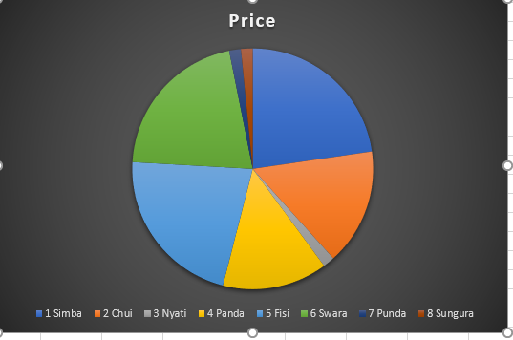
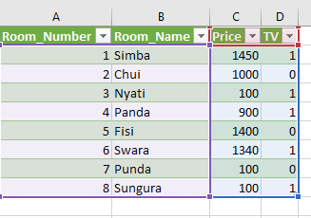
ROOMS DATA
Table containing data
Pie chart representation
Sort by room number:

Slide 5
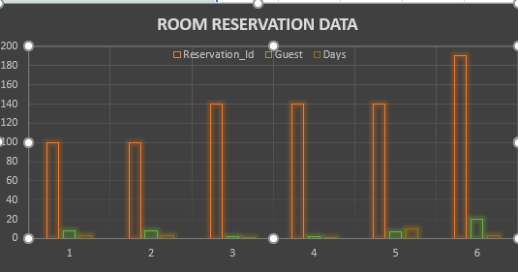
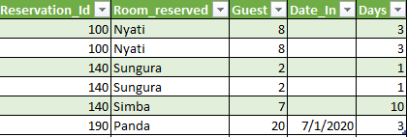
Reservation tabulated data
Bar-graph summary
Reservation attributes

